Slide 2
QUERY OPTIMIZATION
AND
QUERY PROCESSING

Slide 4
CONTENTS
Query Processing
What is Query Optimization?
Query Blocks
External Sorting
Operation implementation
SELECT
JOIN

Slide 6
(cont…) CONTENTS
Query optimization using Heuristics
Query Tree & Query Graph
Query Trees Optimization
Conversion of Query Tree to Execution Plan
Query optimization in ORACLE
Conclusion

Slide 7
INTRODUCTION
Query Processing: The process by which the query results are retrieved from a
high-level query such as SQL or OQL.
Query Optimization: The process of choosing a suitable execution strategy for
retrieving results of query from database files for processing a query is known as
Query Optimization.

Slide 9
Two main Techniques for Query Optimization
Heuristic Rules
Rules for ordering the operations in query optimization.
Systematical estimation
It estimates cost of different execution strategies and chooses the execution plan with lowest execution cost

Slide 10
Steps In Processing High-Level Query
Query in a high-level language
Scanning, Parsing, Validating
Intermediate form of Query
Query Optimizer
Execution Plan
Query Code Generator
Code to execute the query
Runtime Database Processor
Result of Query

Slide 11
Scanning , Parsing , Validating
Scanner: The scanner identifies the language tokens such as SQL Keywords, attribute names, and relation names in the text of the query.
Parser: The parser checks the query syntax to determine whether it is formulated according to the syntax rules of the query language.
Validation: The query must be validated by checking that all attributes and relation names are valid and semantically meaningful names in the schema of the particular database being queried.

Slide 12
QUERY DATA STRUCTURE
Before optimizing the query it is represented in an internal or intermediate form.
It is created using two data structures
Query tree: A tree data structure that corresponds to a relational algebra expression. It represents the input relations of the query as leaf nodes of the tree, and represents the relational algebra operations as internal nodes.
Query graph: A graph data structure that corresponds to a relational calculus expression. It does not indicate an order on which operations to perform first. There is only a single graph corresponding to each query.

Slide 13
QUERY PROCESSING
Query Optimization: The process of choosing a suitable execution strategy for processing a query. This module has the task of producing an execution plan.
Query Code Generator: It generates the code to execute the plan.
Runtime Database Processor: It has the task of running the query code whether in compiled or interpreted mode.If a runtime error results an error message is generated by the runtime database processor.

Slide 14
Translating SQL Queries into Relational Algebra
Query block: The basic unit that can be translated into the algebraic operators and optimized.
A query block contains a single SELECT-FROM-WHERE expression, as well as GROUP BY and HAVING clause if these are part of the block.
Nested queries within a query are identified as separate query blocks.
Aggregate operators in SQL must be included in the extended algebra.

Slide 15
Translating SQL Queries into Relational Algebra
SELECT LNAME, FNAME
FROM EMPLOYEE
WHERE SALARY > (SELECT MAX (SALARY)
FROM EMPLOYEE
WHERE DNO = 5);
SELECT LNAME, FNAME
FROM EMPLOYEE
WHERE SALARY > C
SELECT MAX (SALARY)
FROM EMPLOYEE
WHERE DNO = 5
πLNAME,FNAME(σSALARY>C(EMPLOYEE))
ℱMAX SALARY (σDNO=5 (EMPLOYEE))

Slide 16
Why sort?
A classic problem in computer science!
Data requested in sorted order
e.g., find students in increasing gpa order
Sorting is first step in bulk loading B+ tree index.
Sorting useful for eliminating duplicate copies in a collection of records
Sort-merge join algorithm involves sorting.

Slide 17
Algorithms for External Sorting
When is External sorting used
What is a sub-file and a run
Parameters:
Sorting phase: n_{R} = ⌐(b/n_{B})¬
Merging phase: d_{M} = Min (n_{B}-1, n_{R}); n_{P} = ⌐(log_{dM}(n_{R}))¬
n_{R}: number of initial runs; b: number of file blocks;
n_{B}: available buffer space; d_{M}: degree of merging;
n_{P}: number of passes.

Slide 19
EXTERNAL SORTING
Sorting large files of records that do not fit entirely in main memory.
Sort-merge strategy.
(a) Sort phase
Portions of the file that can fit in the available buffer space are read into the main memory, sorted using an internal sorting algorithm, and written back to disk as temporary sorted sub files (or runs).

Slide 21
(cont..) EXTERNAL SORTING
(b) Merge phase
The sorted runs are merged during one or more passes.

Slide 22
Internal Sorting

Slide 23
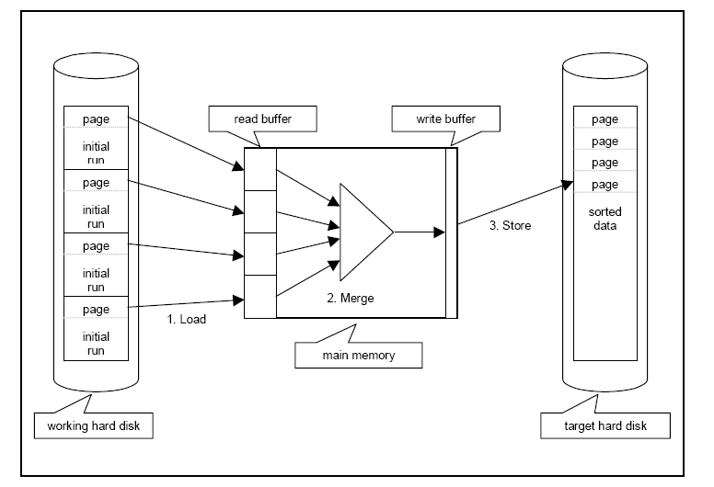
External Merging

Slide 24
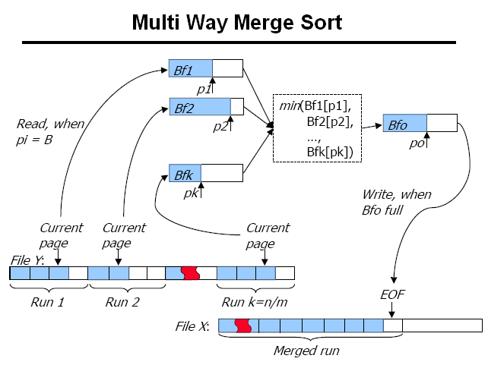

Slide 27
Number of Passes of External Sort

Slide 28
Pictorial Representation of merge sort Functioning

Slide 29
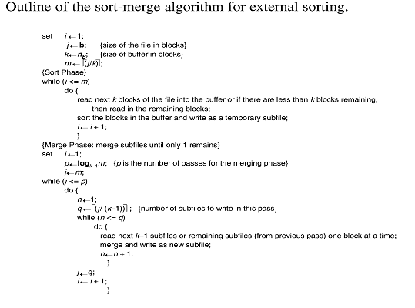

Slide 30
Algorithms for SELECT and JOIN Operations
Implementing the SELECT Operation:
Examples:
(OP1): s _{SSN='123456789'} (EMPLOYEE)
(OP2): s _{DNUMBER>5}(DEPARTMENT)
(OP3): s _{DNO=5}(EMPLOYEE)
(OP4): s DNO=5 AND SALARY>30000 AND SEX=F(EMPLOYEE)
(OP5): s _{ESSN=123456789 AND PNO=10}(WORKS_ON)

Slide 31
Algorithms for SELECT and JOIN Operations
Implementing the SELECT Operation (cont.):
Search Methods for Simple Selection:
S1.Linear search (brute force): Retrieve every record in the file, and test whether its attribute values satisfy the selection condition.
S2.Binary search: If the selection condition involves an equality comparison on a key attribute on which the file is ordered, binary search (which is more efficient than linear search) can be used. (See OP1).
S3.Using a primary index or hash key to retrieve a single record: If the selection condition involves an equality comparison on a key attribute with a primary index (or a hash key), use the primary index (or the hash key) to retrieve the record.

Slide 32
Implementing the SELECT Operation (cont.):
Search Methods for Simple Selection:
S4.Using a primary index to retrieve multiple records: If the comparison condition is >, ≥, <, or ≤ on a key field with a primary index, use the index to find the record satisfying the corresponding equality condition, then retrieve all subsequent records in the (ordered) file.
S5.Using a clustering index to retrieve multiple records: If the selection condition involves an equality comparison on a non-key attribute with a clustering index, use the clustering index to retrieve all the records satisfying the selection condition.

Slide 33
Implementing the SELECT Operation (cont.):
Search Methods for Simple Selection:
S6.Using a secondary (B+-tree) index: On an equality comparison, this search method can be used to retrieve a single record if the indexing field has unique values (is a key) or to retrieve multiple records if the indexing field is not a key. In addition, it can be used to retrieve records on conditions involving >,>=, <, or <=. (FOR RANGE QUERIES)

Slide 34
Implementing the SELECT Operation (cont.):
Search Methods for Complex Selection:
S7.Conjunctive selection: If an attribute involved in any single simple condition in the conjunctive condition has an access path that permits the use of one of the methods S2 to S6, use that condition to retrieve the records and then check whether each retrieved record satisfies the remaining simple conditions in the conjunctive condition.
S8.Conjunctive selection using a composite index: If two or more attributes are involved in equality conditions in the conjunctive condition and a composite index (or hash structure) exists on the combined field, we can use the index directly.

Slide 35
Implementing the SELECT Operation (cont.):
Search Methods for Complex Selection:
S9.Conjunctive selection by intersection of record pointers: This method is possible if secondary indexes are available on all (or some of) the fields involved in equality comparison conditions in the conjunctive condition and if the indexes include record pointers (rather than block pointers). Each index can be used to retrieve the record pointers that satisfy the individual condition. The intersection of these sets of record pointers gives the record pointers that satisfy the conjunctive condition, which are then used to retrieve those records directly. If only some of the conditions have secondary indexes, each retrieved record is further tested to determine whether it satisfies the remaining conditions.

Slide 36
Implementing the SELECT Operation (cont.):
Whenever a single condition specifies the selection, we can only check whether an access path exists on the attribute involved in that condition. If an access path exists, the method corresponding to that access path is used; otherwise, the “brute force” linear search approach of method S1 is used. (See OP1, OP2 and OP3)
For conjunctive selection conditions, whenever more than one of the attributes involved in the conditions have an access path, query optimization should be done to choose the access path that retrieves the fewest records in the most efficient way .
Disjunctive selection conditions

Slide 37
Implementing the JOIN Operation:
Join (EQUIJOIN, NATURAL JOIN)
two–way join: a join on two files
e.g. R _{A=B} S
multi-way joins: joins involving more than two files.
e.g. R _{A=B} S _{C=D} T
Examples
(OP6): EMPLOYEE _{DNO=DNUMBER} DEPARTMENT
(OP7): DEPARTMENT _{MGRSSN=SSN} EMPLOYEE

Slide 38
Implementing the JOIN Operation (cont.):
Methods for implementing joins:
J1Nested-loop join (brute force): For each record t in R (outer loop), retrieve every record s from S (inner loop) and test whether the two records satisfy the join condition t[A] = s[B].
J2.Single-loop join (Using an access structure to retrieve the matching records): If an index (or hash key) exists for one of the two join attributes — say, B of S — retrieve each record t in R, one at a time, and then use the access structure to retrieve directly all matching records s from S that satisfy s[B] = t[A].

Slide 39
Implementing the JOIN Operation (cont.):
Methods for implementing joins:
J3.Sort-merge join: If the records of R and S are physically sorted (ordered) by value of the join attributes A and B, respectively, we can implement the join in the most efficient way possible. Both files are scanned in order of the join attributes, matching the records that have the same values for A and B. In this method, the records of each file are scanned only once each for matching with the other file—unless both A and B are non-key attributes, in which case the method needs to be modified slightly

Slide 40
Implementing the JOIN Operation (cont.):
Methods for implementing joins:
J4.Hash-join: The records of files R and S are both hashed to the same hash file, using the same hashing function on the join attributes A of R and B of S as hash keys. A single pass through the file with fewer records (say, R) hashes its records to the hash file buckets. A single pass through the other file (S) then hashes each of its records to the appropriate bucket, where the record is combined with all matching records from R.

Slide 41
Process for heuristics optimization
The parser of a high-level query generates an initial internal representation;
Apply heuristics rules to optimize the internal representation.
A query execution plan is generated to execute groups of operations based on the access paths available on the files involved in the query.
The main heuristic is to apply first the operations that reduce the size of intermediate results.
E.g., Apply SELECT and PROJECT operations before applying the JOIN or other binary operations.

Slide 42
Query tree: a tree data structure that corresponds to a relational algebra expression. It represents the input relations of the query as leaf nodes of the tree, and represents the relational algebra operations as internal nodes.
An execution of the query tree consists of executing an internal node operation whenever its operands are available and then replacing that internal node by the relation that results from executing the operation.
Query graph: a graph data structure that corresponds to a relational calculus expression. It does not indicate an order on which operations to perform first. There is only a single graph corresponding to each query.

Slide 43
Example:
For every project located in ‘Stafford’, retrieve the project number, the controlling department number and the department manager’s last name, address and birthdate.
Relation algebra:
πPNUMBER, DNUM, LNAME, ADDRESS, BDATE (((σ_{PLOCATION=‘STAFFORD’}(PROJECT))
_{DNUM=DNUMBER} (DEPARTMENT)) _{MGRSSN=SSN} (EMPLOYEE))
SQL query:
Q2: SELECT P.NUMBER,P.DNUM,E.LNAME, E.ADDRESS, E.BDATE
FROM PROJECT AS P,DEPARTMENT AS D, EMPLOYEE AS E
WHERE P.DNUM=D.DNUMBER AND D.MGRSSN=E.SSN AND
P.PLOCATION=‘STAFFORD’;

Slide 44
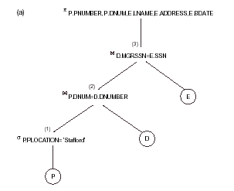
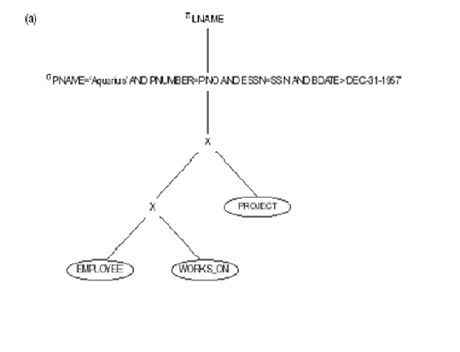
The same query could correspond to many different relational algebra expressions — and hence many different query trees.

Slide 46
Query Graph
Nodes represents Relations.
Ovals represents constant nodes.
Edges represents Join & Selection conditions.
Attributes to be retrieved from relations represented in square brackets.
Drawback :- Does not indicate an order on which operations are performed.

Slide 47
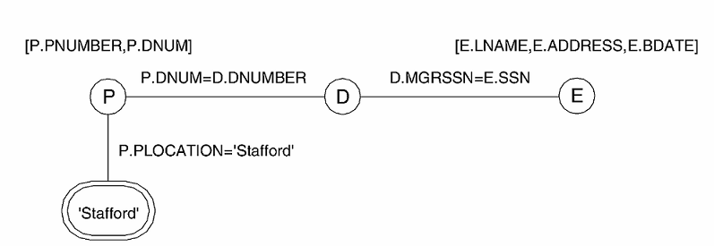
There is only a single graph corresponding to each query.

Slide 48
Heuristic Query Tree Optimization
It has some rules which utilize equivalence expressions to transform the initial tree into final, optimized query tree.
For Example :
SELECT LNAME
FROM EMPLOYEE, WORKS_ON, PROJECT
WHERE PNAME= ‘AQUARIUS’ AND PNUMBER=PNO AND ESSN=SSN AND BDATE > ‘1957-12-31’

Slide 49
Heuristic Query Tree Optimization
It has some rules which utilize equivalence expressions to transform the initial tree into final, optimized query tree.
For Example :
SELECT LNAME
FROM EMPLOYEE, WORKS_ON, PROJECT
WHERE PNAME= ‘AQUARIUS’ AND PNUMBER=PNO AND ESSN=SSN AND BDATE > ‘1957-12-31’

Slide 50
(CONT…) Query Tree Optimization
PROJ(LNAME)
SELECT(P.PNAME=‘Aquarius’ AND PNUMBER=PNO AND ESSN=SSN X ANDBDATE>’1957-12-31’)
X
X
PROJECT
WORK_ON
EMPLOYEE
FIG1 : INITIAL QUERY TREE

Slide 51
(CONT…) Query Tree Optimization
PROJ(LNAME)
SELECT( PNUMBER=PNO )
X
SELECT(ESSN=SSN)
SELECT(PNAME=‘Aquarius’)
X
PROJECT
SELECT(BDATE>’1957-12-31’)
WORK_ON
EMPLOYEE
FIG2 : MOVE SELECT DOWN THE TREE USING CASCADE & COMMUTATIVITY RULE OF SELECT OPERATION

Slide 52
(CONT…) Query Tree Optimization
PROJ(LNAME)
SELECT( ESSN=SSN )
X
SELECT(PNUMBER=PNO)
SELECT(BDATE>’1957-12-31’)
X
EMPLOYEE
SELECT(PNAME=‘Aquarius’)
WORK_ON
PROJECT
FIG3 : REARRANGE OF LEAF NODES, USING COMMUTATIVITY & ASSOCIATIVITY OF BINARY OPERATIONS.

Slide 53
(CONT…) Query Tree Optimization
PROJ(LNAME)
JOIN( ESSN=SSN )
JOIN(PNUMBER=PNO)
SELECT(BDATE>’1957-12-31’)
EMPLOYEE
SELECT(PNAME=‘Aquarius’)
WORK_ON
PROJECT
FIG4 : CONVERTING SELECT & CARTESIAN PRODUCT INTO JOIN

Slide 54
(CONT…) Query Tree Optimization
PROJ(LNAME)
JOIN( ESSN=SSN )
PROJ(ESSN)
PROJ(SSN,LNAME)
JOIN(PNUMBER=PNO)
SELECT(BDATE>’1957-12-31’)
PROJ(PNUMBER)
PROJ(ESSN,PNO)
EMPLOYEE
SELECT(PNAME=‘Aquarius’)
WORK_ON
PROJECT
FIG4 : BREAK-MOVE OF PROJECT USING CASCADE & COMMUTING RULES OF PROJECT OPERATIONS.

Slide 55
(CONT…) Query Tree Optimization
Summary :- The main idea behind is to reduce intermediate results. This includes performing SELECT operation to reduce the number of tuples & PROJECT operation to reduce number of attributes.

Slide 56
General Transformation Rules for Relational Algebra Operations:
Cascade of σ: A conjunctive selection condition can be broken up into a cascade (sequence) of individual s operations: σ _{c1 AND c2 AND ... AND cn}(R) = σ_{c1} (σ_{c2} (...(σ_{cn}(R))...) )
Commutativity of σ: The σ operation is commutative: σ_{c1} (σ_{c2}(R)) = σ_{c2} (σ_{c1}(R))
Cascade of π: In a cascade (sequence) of π operations, all but the last one can be ignored:
π_{List1} (π_{List2} (...(π_{Listn}(R))...) ) = π_{List1}(R)
Commuting σ with π: If the selection condition c involves only the attributes A1, ..., An in the projection list, the two operations can be commuted:
π_{A1, A2, ..., An} (σ_{c} (R)) = σ_{c} (π_{A1, A2, ..., An} (R))

Slide 57
Commutativity of ( and x ): The operation is commutative as is the x operation: R _{C} S = S _{C} R; R x S = S x R
Commuting σ with (or x ): If all the attributes in the selection condition c involve only the attributes of one of the relations being joined—say, R—the two operations can be commuted as follows :
σ_{c} ( R S ) = (σ_{c} (R)) S
Alternatively, if the selection condition c can be written as (c1 and c2), where condition c1 involves only the attributes of R and condition c2 involves only the attributes of S, the operations commute as follows:
σ_{c} ( R S ) = (σ_{c1} (R)) (σ_{c2} (S))

Slide 58
Commuting π with (or x ): Suppose that the projection list is L = {A1, ..., An, B1, ..., Bm}, where A1, ..., An are attributes of R and B1, ..., Bm are attributes of S. If the join condition c involves only attributes in L, the two operations can be commuted as follows:
π_{L} ( R _{C} S ) = (π_{A1, ..., An} (R)) _{C} (π_{B1, ..., Bm} (S))
If the join condition c contains additional attributes not in L, these must be added to the projection list, and a final π operation is needed.

Slide 59
Commutativity of set operations: The set operations υ and ∩ are commutative but – is not.
Associativity of , x, υ, and ∩ : These four operations are individually associative; that is, if θ stands for any one of these four operations (throughout the expression), we have ( R θ S ) θ T = R θ ( S θ T )
Commuting σ with set operations: The σ operation commutes with υ , ∩ , and –. If θ stands for any one of these three operations, we have
σ_{c} ( R θ S ) = (σ_{c} (R)) θ (σ_{c} (S))

Slide 60
The π operation commutes with υ. π_{L} ( R υ S ) = (π_{L} (R)) υ (π_{L} (S))
Converting a (σ, x) sequence into : If the condition c of a σ that follows a x Corresponds to a join condition, convert the (σ, x) sequence into a as follows: (σ_{C} (R x S)) = (R _{C} S)
Other transformations

Slide 61
Outline of a Heuristic Algebraic Optimization Algorithm:
Using rule 1, break up any select operations with conjunctive conditions into a cascade of select operations.
Using rules 2, 4, 6, and 10 concerning the commutativity of select with other operations, move each select operation as far down the query tree as is permitted by the attributes involved in the select condition.
Using rule 9 concerning associativity of binary operations, rearrange the leaf nodes of the tree so that the leaf node relations with the most restrictive select operations are executed first in the query tree representation.
Using Rule 12, combine a cartesian product operation with a subsequent select operation in the tree into a join operation.

Slide 62
Using rules 3, 4, 7, and 11 concerning the cascading of project and the commuting of project with other operations, break down and move lists of projection attributes down the tree as far as possible by creating new project operations as needed.
Identify subtrees that represent groups of operations that can be executed by a single algorithm.

Slide 63
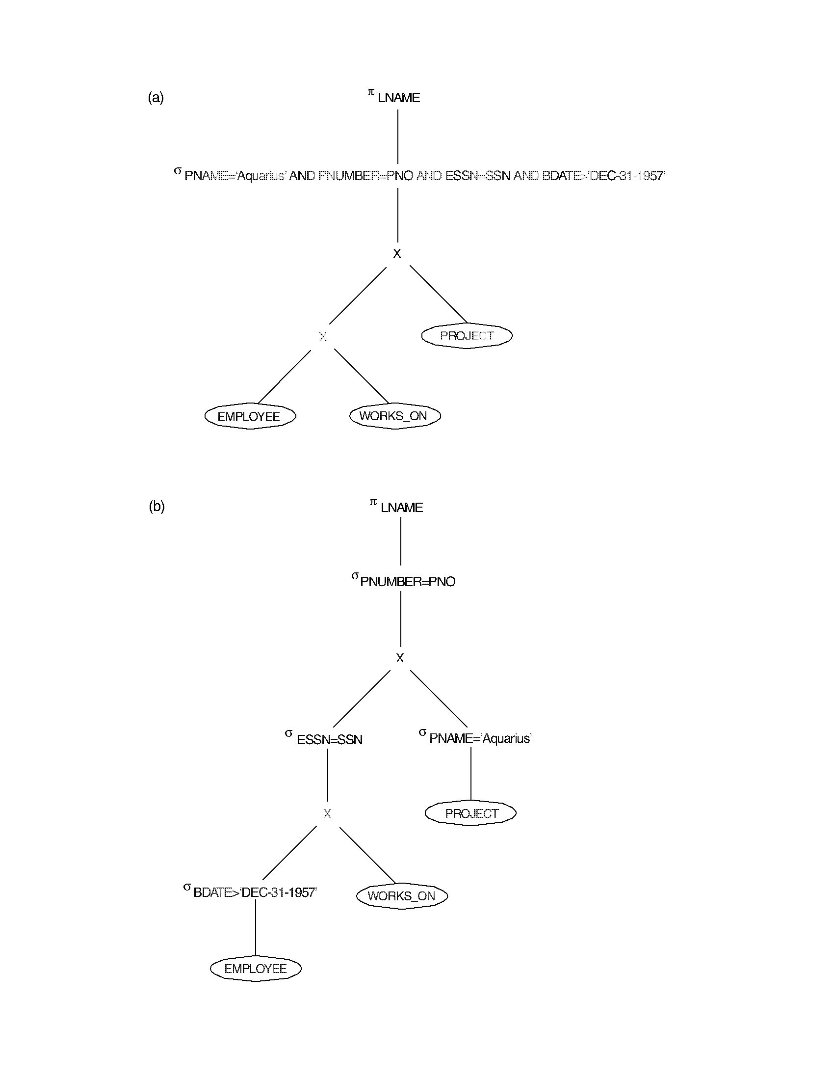

Slide 64
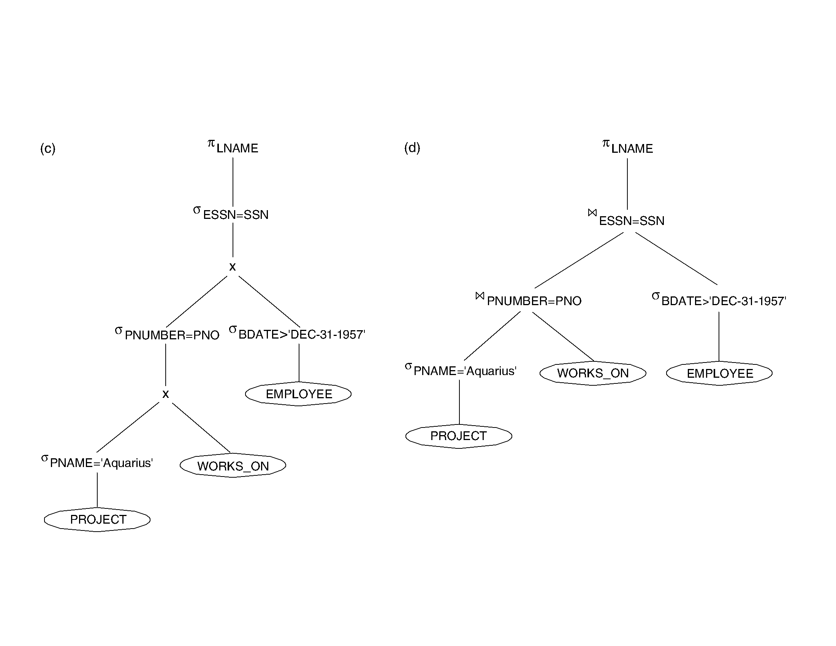

Slide 65
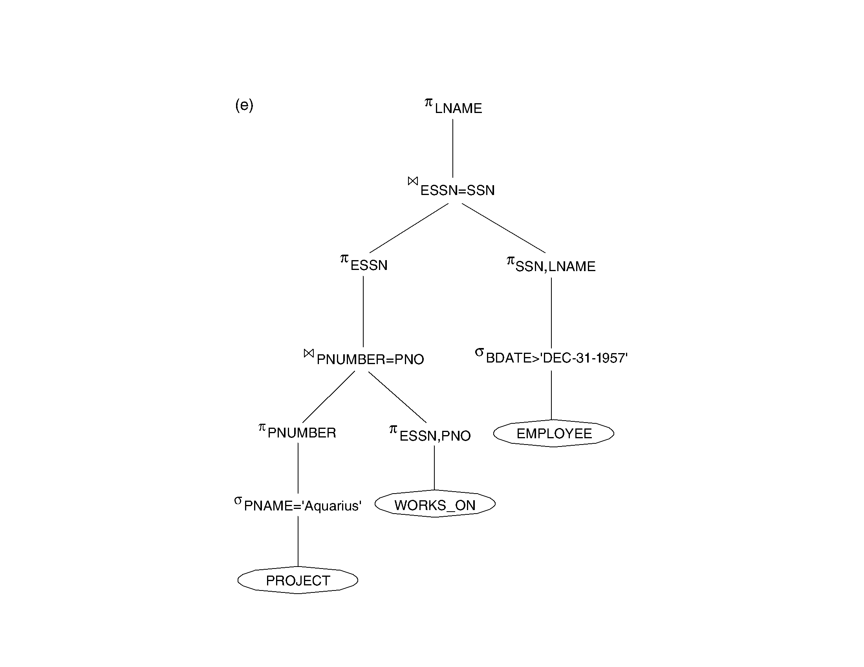

Slide 66
Query Execution Plans
An execution plan for a relational algebra query consists of a combination of the relational algebra query tree and information about the access methods to be used for each relation as well as the methods to be used in computing the relational operators stored in the tree.
Materialized evaluation: the result of an operation is stored as a temporary relation.
Pipelined evaluation: as the result of an operator is produced, it is forwarded to the next operator in sequence.

Slide 67
Oracle DBMS V8
Rule-based query optimization: the optimizer chooses execution plans based on heuristically ranked operations.
(Currently it is being phased out)
Cost-based query optimization: the optimizer examines alternative access paths and operator algorithms and chooses the execution plan with lowest estimate cost. The query cost is calculated based on the estimated usage of resources such as I/O, CPU and memory needed.
Application developers could specify hints to the ORACLE query optimizer. The idea is that an application developer might know more information about the data.

